Slide 1

covid19 usa vaccination data
Presented by:
Akanksha, Cameron and Brad

Slide 2
Data Source
CSV file from Kaggle.com
and
JSON data from Covidtracking.com
Notes:
Kaggle = COVID Vaccination Data
CovidTracking.com = COVID Cases Data

Slide 3
Libraries Utilized
Extract
Use pandas to extract data from source.
Transform
Cleaned up the CSV in various ways including:
Dropped columns
Reassigned data types
“int” to “datetime”
“object” to “int”
Dropped Nan values
By doing this, several dates were dropped. This necessitated additional date filtering to line up the JSON data with the CSV file.
Filtered by target country (USA)
Pandas
Datetime
Numpy
Psycopg2
SQLAlchemy

Slide 4
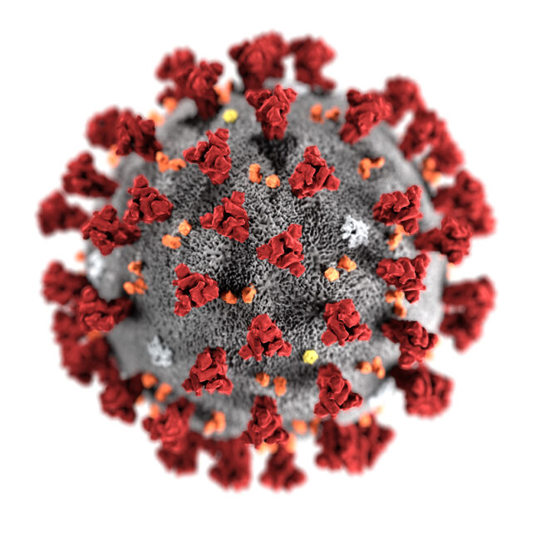
Transform
Cleaned up the JSON in various ways including:
No API key was required as the data is public.
Filtered by “date”, “positive” and “negative” cases.
Dropped Nan values.
Reassigned data types
“float” to “int”
“int” to “Datetime”
In converting to “Datetime” we found it necessary to first convert ”int” to ”string” and then ”string” to ”Datetime”.
Sorted values in ascending order to match CSV data.
Filtered date range to match CSV data due to the fact that the Vaccine data necessarily had a narrower range of dates than COVID cases data.

Slide 5
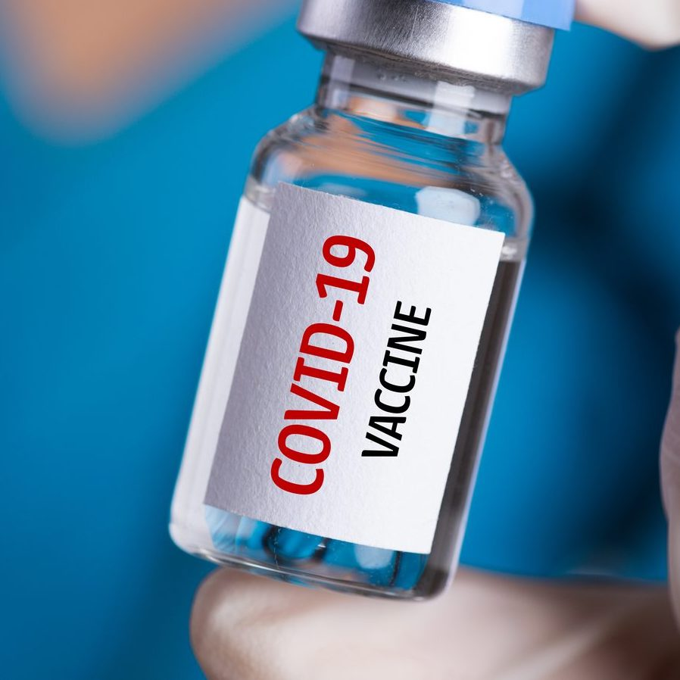
Load
Created tables in pgAdmin.
Used psycopg2 within Jupyter Notebook to create engine and fetch data from pgAdmin.
Joined the tables (COVID Vaccination data from CSV and COVID Cases data from JSON) based on date for the final product.
Our final product resulted in a unified dataframe that would give an analyst the ability to draw conclusions regarding growth of vaccine availability and decrease in cases.

Slide 6
